Slide 1
CSE322
Formal Languages and Automation Theory
Lecture: TM
School of Computer Science and Engineering

Slide 2

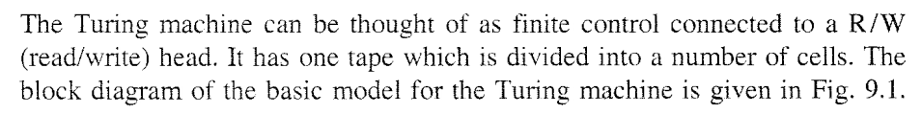
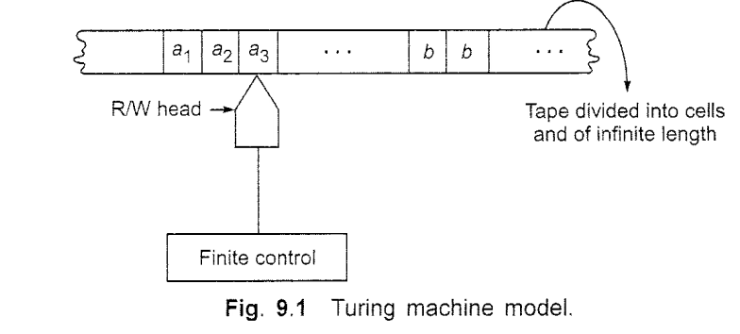

Slide 3
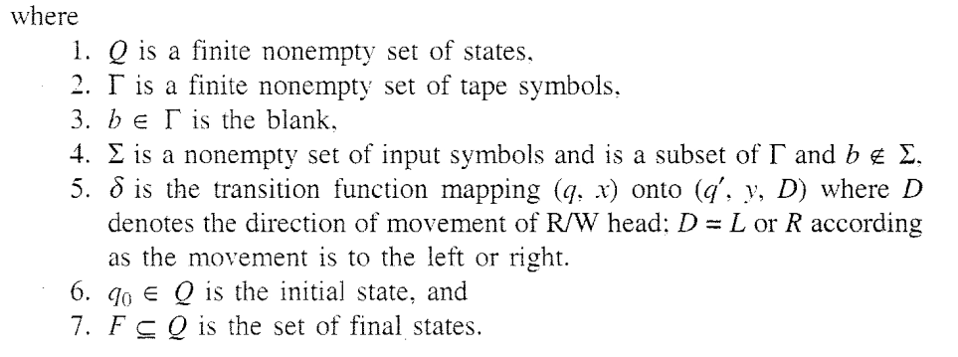
Cont…

Slide 5

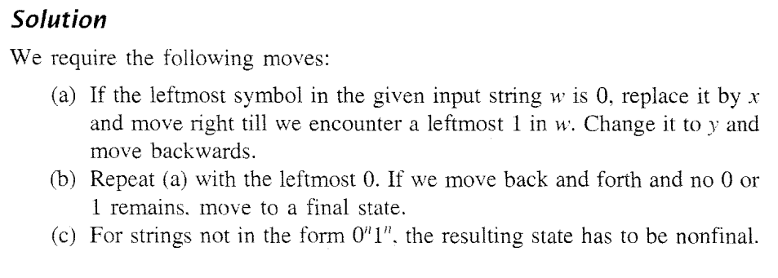
Basics of TM Design

Slide 6
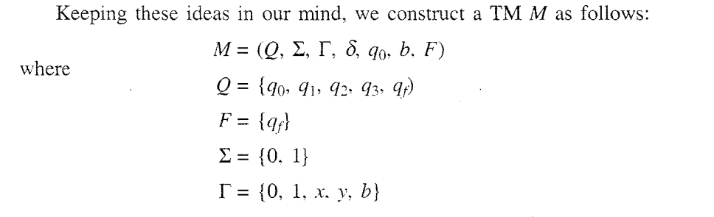
Cont…

Slide 7
Example
Lets Design TM for,
a^n b^n, where n>0
So here Σ = {a,b} and Γ ={a,b,x,y,B}

Slide 8
Cont…
B | B | a | a | a | b | b | b | B | B
q0
(a,x,R)
q1

Slide 9
Cont…
B | B | x | a | a | b | b | b | B | B
q0
(a,x,R)
q1

Slide 10
Cont…
B | B | x | a | a | b | b | b | B | B
(a,a,R)
q0
(a,x,R)
q1

Slide 11
Cont…
B | B | x | a | a | b | b | b | B | B
(a,a,R)
q0
(a,x,R)
q1

Slide 12
Cont…
B | B | x | a | a | b | b | b | B | B
(a,a,R)
q0
(a,x,R)
q1
(b,y,L)
q2

Slide 13
Cont…
B | B | x | a | a | y | b | b | B | B
(a,a,R)
q0
(a,x,R)
q1
(b,y,L)
q2

Slide 14
Cont…
B | B | x | a | a | y | b | b | B | B
(a,a,R)
(a,a,L)
q0
(a,x,R)
q1
(b,y,L)
q2

Slide 15
Cont…
B | B | x | a | a | y | b | b | B | B
(a,a,R)
(a,a,L)
q0
(a,x,R)
q1
(b,y,L)
q2

Slide 16
Cont…
B | B | x | a | a | y | b | b | B | B
(a,a,R)
(a,a,L)
q0
(a,x,R)
q1
(b,y,L)
q2
(x,x,R)

Slide 17
Cont…
B | B | x | a | a | y | b | b | B | B
(a,a,R)
(a,a,L)
q0
(a,x,R)
q1
(b,y,L)
q2
(x,x,R)

Slide 18
Cont…
B | B | x | x | a | y | b | b | B | B
(a,a,R)
(a,a,L)
q0
(a,x,R)
q1
(b,y,L)
q2
(x,x,R)

Slide 19
Cont…
B | B | x | x | a | y | b | b | B | B
(a,a,R)
(a,a,L)
q0
(a,x,R)
q1
(b,y,L)
q2
(x,x,R)

Slide 20
Cont…
B | B | x | x | a | y | b | b | B | B
(y,y,R)
(a,a,R)
(a,a,L)
q0
(a,x,R)
q1
(b,y,L)
q2
(x,x,R)

Slide 21
Cont…
B | B | x | x | a | y | b | b | B | B
(y,y,R)
(a,a,R)
(a,a,L)
q0
(a,x,R)
q1
(b,y,L)
q2
(x,x,R)

Slide 22
Cont…
B | B | x | x | a | y | y | b | B | B
(y,y,R)
(a,a,R)
(a,a,L)
q0
(a,x,R)
q1
(b,y,L)
q2
(x,x,R)

Slide 23
Cont…
B | B | x | x | a | y | y | b | B | B
(y,y,R)
(a,a,R)
(a,a,L)
(y,y,L)
q0
(a,x,R)
q1
(b,y,L)
q2
(x,x,R)

Slide 24
Cont…
B | B | x | x | a | y | y | b | B | B
(y,y,R)
(a,a,R)
(a,a,L)
(y,y,L)
q0
(a,x,R)
q1
(b,y,L)
q2
(x,x,R)

Slide 25
Cont…
B | B | x | x | a | y | y | b | B | B
(y,y,R)
(a,a,R)
(a,a,L)
(y,y,L)
q0
(a,x,R)
q1
(b,y,L)
q2
(x,x,R)

Slide 26
Cont…
B | B | x | x | a | y | y | b | B | B
(y,y,R)
(a,a,R)
(a,a,L)
(y,y,L)
q0
(a,x,R)
q1
(b,y,L)
q2
(x,x,R)

Slide 27
Cont…
B | B | x | x | x | y | y | b | B | B
(y,y,R)
(a,a,R)
(a,a,L)
(y,y,L)
q0
(a,x,R)
q1
(b,y,L)
q2
(x,x,R)

Slide 28
Cont…
B | B | x | x | x | y | y | b | B | B
(y,y,R)
(a,a,R)
(a,a,L)
(y,y,L)
q0
(a,x,R)
q1
(b,y,L)
q2
(x,x,R)

Slide 29
Cont…
B | B | x | x | x | y | y | b | B | B
(y,y,R)
(a,a,R)
(a,a,L)
(y,y,L)
q0
(a,x,R)
q1
(b,y,L)
q2
(x,x,R)

Slide 30
Cont…
B | B | x | x | x | y | y | b | B | B
(y,y,R)
(a,a,R)
(a,a,L)
(y,y,L)
q0
(a,x,R)
q1
(b,y,L)
q2
(x,x,R)

Slide 31
Cont…
B | B | x | x | x | y | y | y | B | B
(y,y,R)
(a,a,R)
(a,a,L)
(y,y,L)
q0
(a,x,R)
q1
(b,y,L)
q2
(x,x,R)

Slide 32
Cont…
B | B | x | x | x | y | y | y | B | B
(y,y,R)
(a,a,R)
(a,a,L)
(y,y,L)
q0
(a,x,R)
q1
(b,y,L)
q2
(x,x,R)

Slide 33
Cont…
B | B | x | x | x | y | y | y | B | B
(y,y,R)
(a,a,R)
(a,a,L)
(y,y,L)
q0
(a,x,R)
q1
(b,y,L)
q2
(x,x,R)

Slide 34
Cont…
B | B | x | x | x | y | y | y | B | B
(y,y,R)
(a,a,R)
(a,a,L)
(y,y,L)
q0
(a,x,R)
q1
(b,y,L)
q2
(x,x,R)

Slide 35
Cont…
B | B | x | x | x | y | y | y | B | B
(y,y,R)
(a,a,R)
(a,a,L)
(y,y,L)
q0
(a,x,R)
q1
(b,y,L)
q2
(y,y,R)
(x,x,R)
q3

Slide 36
Cont…
B | B | x | x | x | y | y | y | B | B
(y,y,R)
(a,a,R)
(a,a,L)
(y,y,L)
q0
(a,x,R)
q1
(b,y,L)
q2
(y,y,R)
(x,x,R)
q3
(y,y,R)

Slide 37
Cont…
B | B | x | x | x | y | y | y | B | B
(y,y,R)
(a,a,R)
(a,a,L)
(y,y,L)
q0
(a,x,R)
q1
(b,y,L)
q2
(y,y,R)
(x,x,R)
q3
(y,y,R)

Slide 38
Cont…
B | B | x | x | x | y | y | y | B | B
(y,y,R)
(a,a,R)
(a,a,L)
(y,y,L)
q0
(a,x,R)
q1
(b,y,L)
q2
(y,y,R)
(x,x,R)
q3
(B,B,R)
q4
(y,y,R)

Slide 39
Class Work
a^n b^n c^n, Where n>0

Slide 40
Linear Bounded Automata
The computation is restricted to the constant bounded area.
The input alphabet contains two special symbols which serve as left end markers and right end markers which mean the transitions neither move to the left of the left end marker nor to the right of the right end marker of the tape.

Slide 41
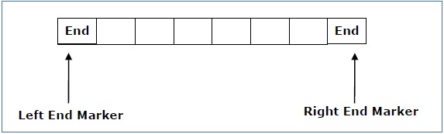
Cont…

Slide 42
Cont.
A linear bounded automaton can be defined as an 8-tuple (Q, Γ, ∑, q₀, ML, MR, δ, F) where
Q is a finite set of states
Γ is the tape alphabet
∑ is the input alphabet
q₀ is the initial state
M_{L} is the left end marker
M_{R} is the right end marker where M_{R} ≠ M_{L}
δ is a transition function
F is the set of final states

Slide 43
Design LBA
a^n b^n c^n, Where n>0

Slide 44
Variation in TM
Single Tap TM
Multi Tap TM
Single head TM
Multi head TM
TM with Single direction of Tap infinite
TM without writing capacity
TM with input size tap

Slide 45
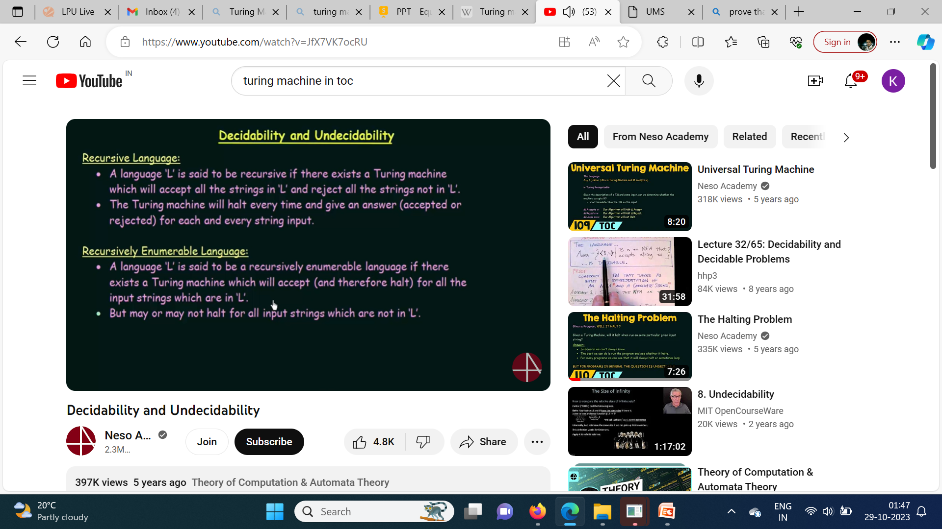

Slide 46
Cont…
Recursively Enumerable Language
A language, in which string can reach either at Accept state and halt, or at reject state and halt or enter in infinite loop at any state.
Recursively Language
A language, in which string can reach either at Accept state and halt, or at reject state and halt.

Slide 47
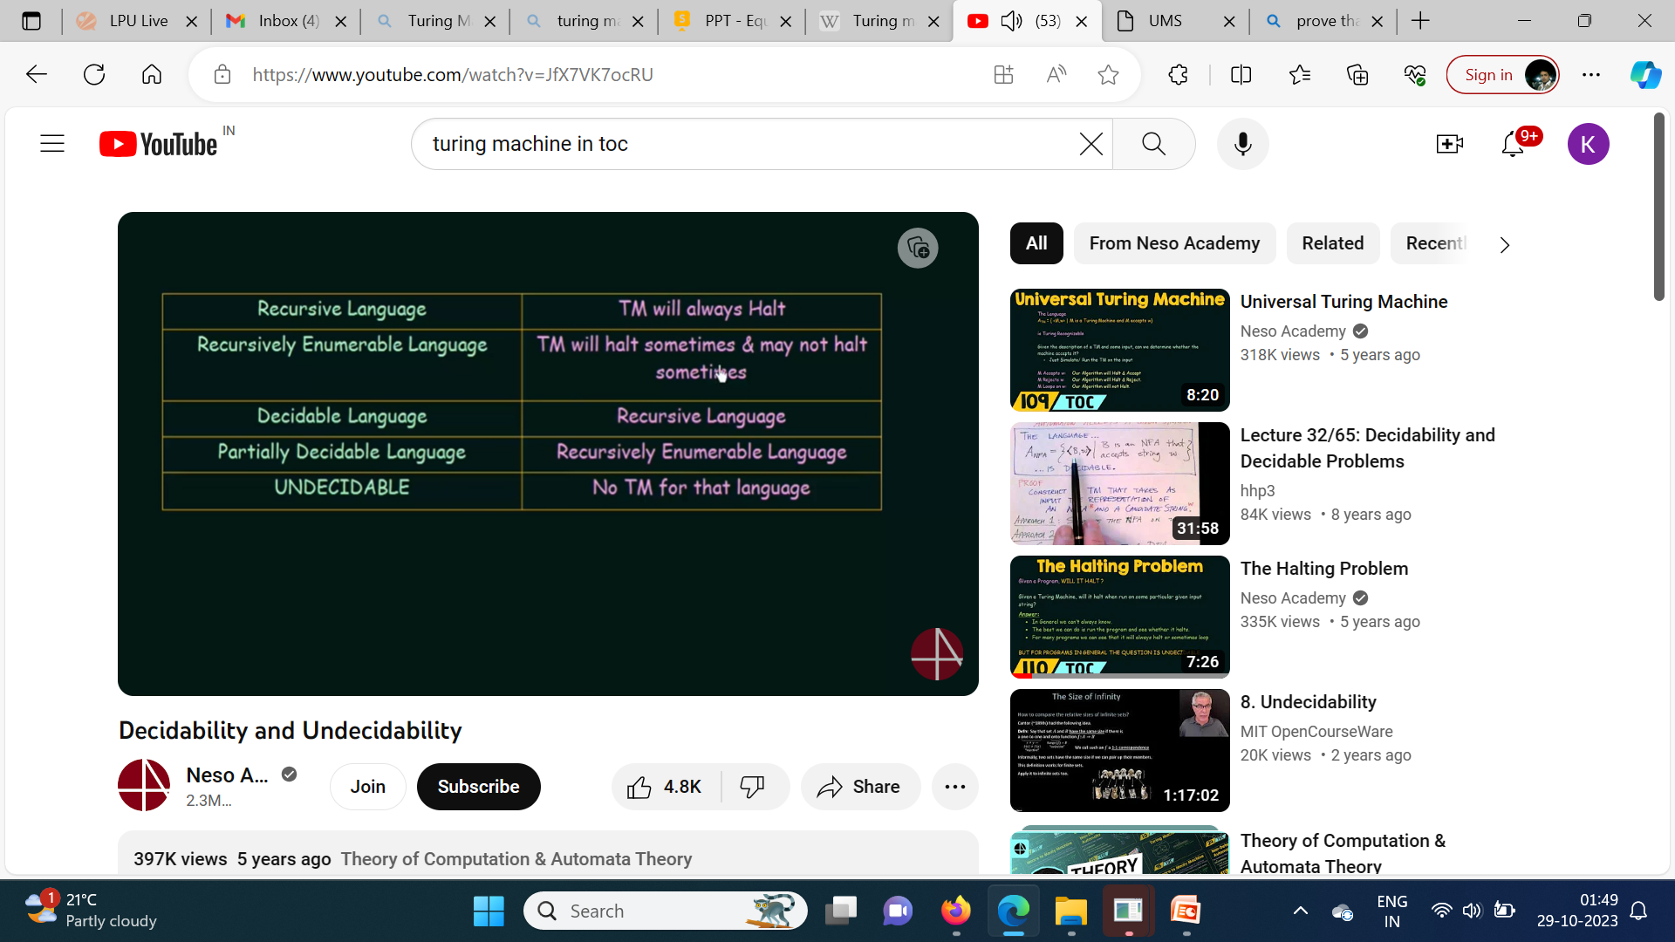

Slide 48
Decidable and Undecidable
In the Theory of Computation, problems can be classified into decidable and undecidable categories based on whether they can be solved using an algorithm.
A decidable problem is one for which a solution can be found in a finite amount of time, meaning there exists an algorithm that can always provide a correct answer.
While an undecidable problem is one where no algorithm can be constructed to solve the problem for all possible inputs.

Slide 49
Cont…
 | Regular | CFL | CSL | Recursive | Recursively Enumerable
Membership Problem W∈Σ* | D | D | D | D | UnD
Infiniteness/Finiteness Problem | D | D | UnD | UnD | UnD
Emptiness Problem L=Φ | D | D | UnD | UnD | UnD
Equality Problem L1=L2 | D | UnD | UnD | UnD | UnD
Ambiguity | D | UnD | UnD | UnD | UnD
Compliments L=Σ* | D | UnD | UnD | UnD | UnD
L1∩L2 | D | UnD | UnD | UnD | UnD
If L1⊆L2 | D | UnD | UnD | UnD | UnD

Slide 50
Time and Space Complexity of a Turing Machine
For a Turing machine, the time complexity refers to the measure of the number of times the tape moves when the machine is initialized for some input symbols and the space complexity is the number of cells of the tape written.
Time complexity all reasonable functions −
T(n) = O(n log n)
TM's space complexity −
S(n) = O(n)

Slide 51
Post Correspondence Problem
Post Correspondence Problem is a popular undecidable problem that was introduced by Emil Leon Post in 1946.
In this problem we have N number of Dominos (tiles). The aim is to arrange tiles in such order that string made by Numerators is same as string made by Denominators.

Slide 52
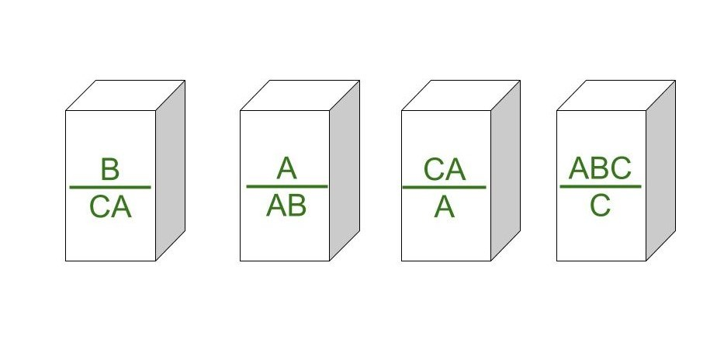
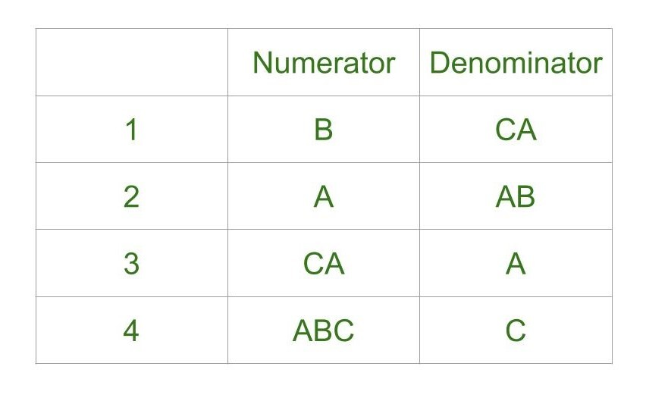
Cont…
Post Correspondence Problems can be represented in two ways,

Slide 53
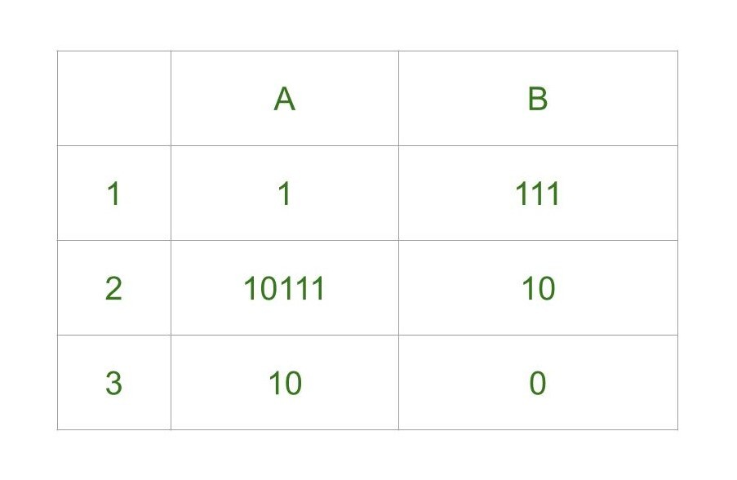
Example-1:
Step-1: We will start with tile in which numerator and denominator are starting with same number, so we can start with either 1 or 2. Lets go with second tile, string made by numerator- 10111, string made by denominator is 10.
Step-2: We need 1s in denominator to match 1s in numerator so we will go with first tile, string made by numerator is 10111 1, string made by denominator is 10 111.
Step-3: There is extra 1 in numerator to match this 1 we will add first tile in sequence, string made by numerator is now 10111 1 1, string made by denominator is 10 111 111.
Step-4: Now there is extra 1 in denominator to match it we will add third tile, string made by numerator is 10111 1 1 10, string made by denominator is 10 111 111 0.

Slide 54
Cont…
Final Solution - 2 1 1 3
String made by numerators: 101111110
String made by denominators: 101111110

Slide 55
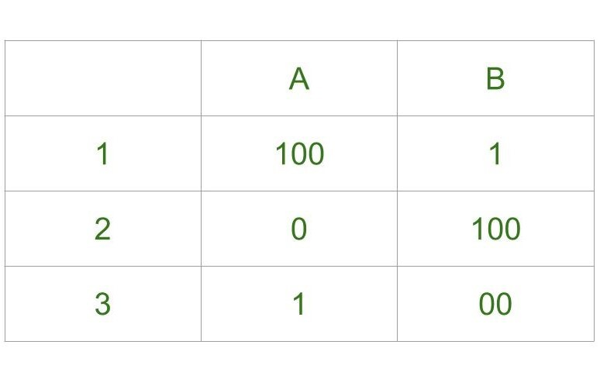
Example-2
Step-1: We will start from tile 1 as it is our only option, string made by numerator is 100, string made by denominator is 1.
Step-2: We have extra 00 in numerator, to balance this only way is to add tile 3 to sequence, string made by numerator is 100 1, string made by denominator is 1 00.
Step-3: There is extra 1 in numerator to balance we can add tile 1. Lets try adding tile 1, string made by numerator is 100 1 100, string made by denominator is 1 00 1.
Step-4: There is extra 100 in numerator, to balance this we can add 1st tile again, string made by numerator is 100 1 100 100, string made by denominator is 1 00 1 1 1. The 6th digit in numerator string is 0 which is different from 6th digit in string made by denominator which is 1.

Slide 56
Cont…
We can try unlimited combinations like one above but none of combination will lead us to solution, thus this problem does not have solution. Undecidability of Post Correspondence Problem : As theorem says that PCP is undecidable. That is, there is no particular algorithm that determines whether any Post Correspondence System has solution or not.

